Slide 1
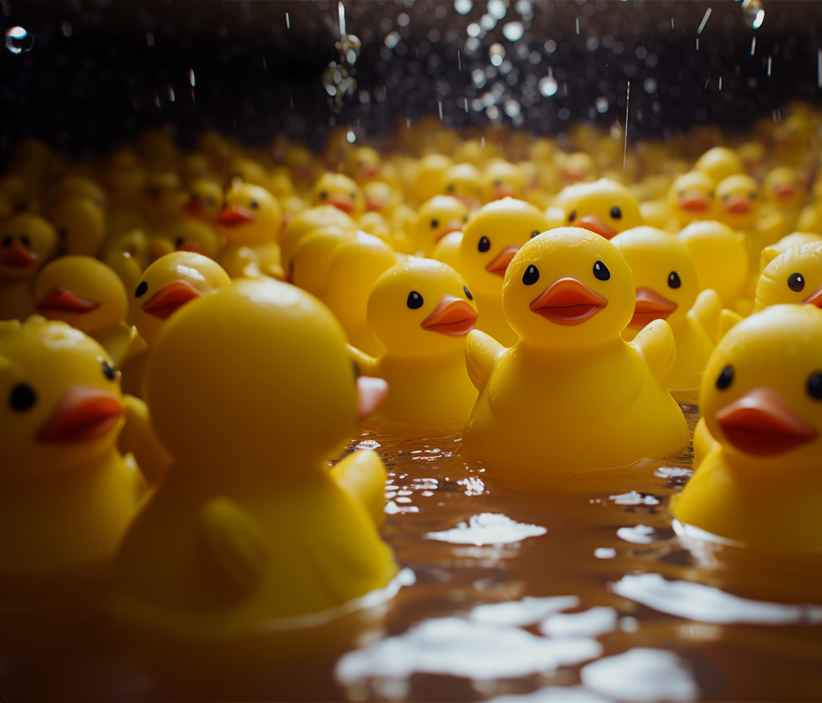


Intro to Rubber Ducky

Slide 2
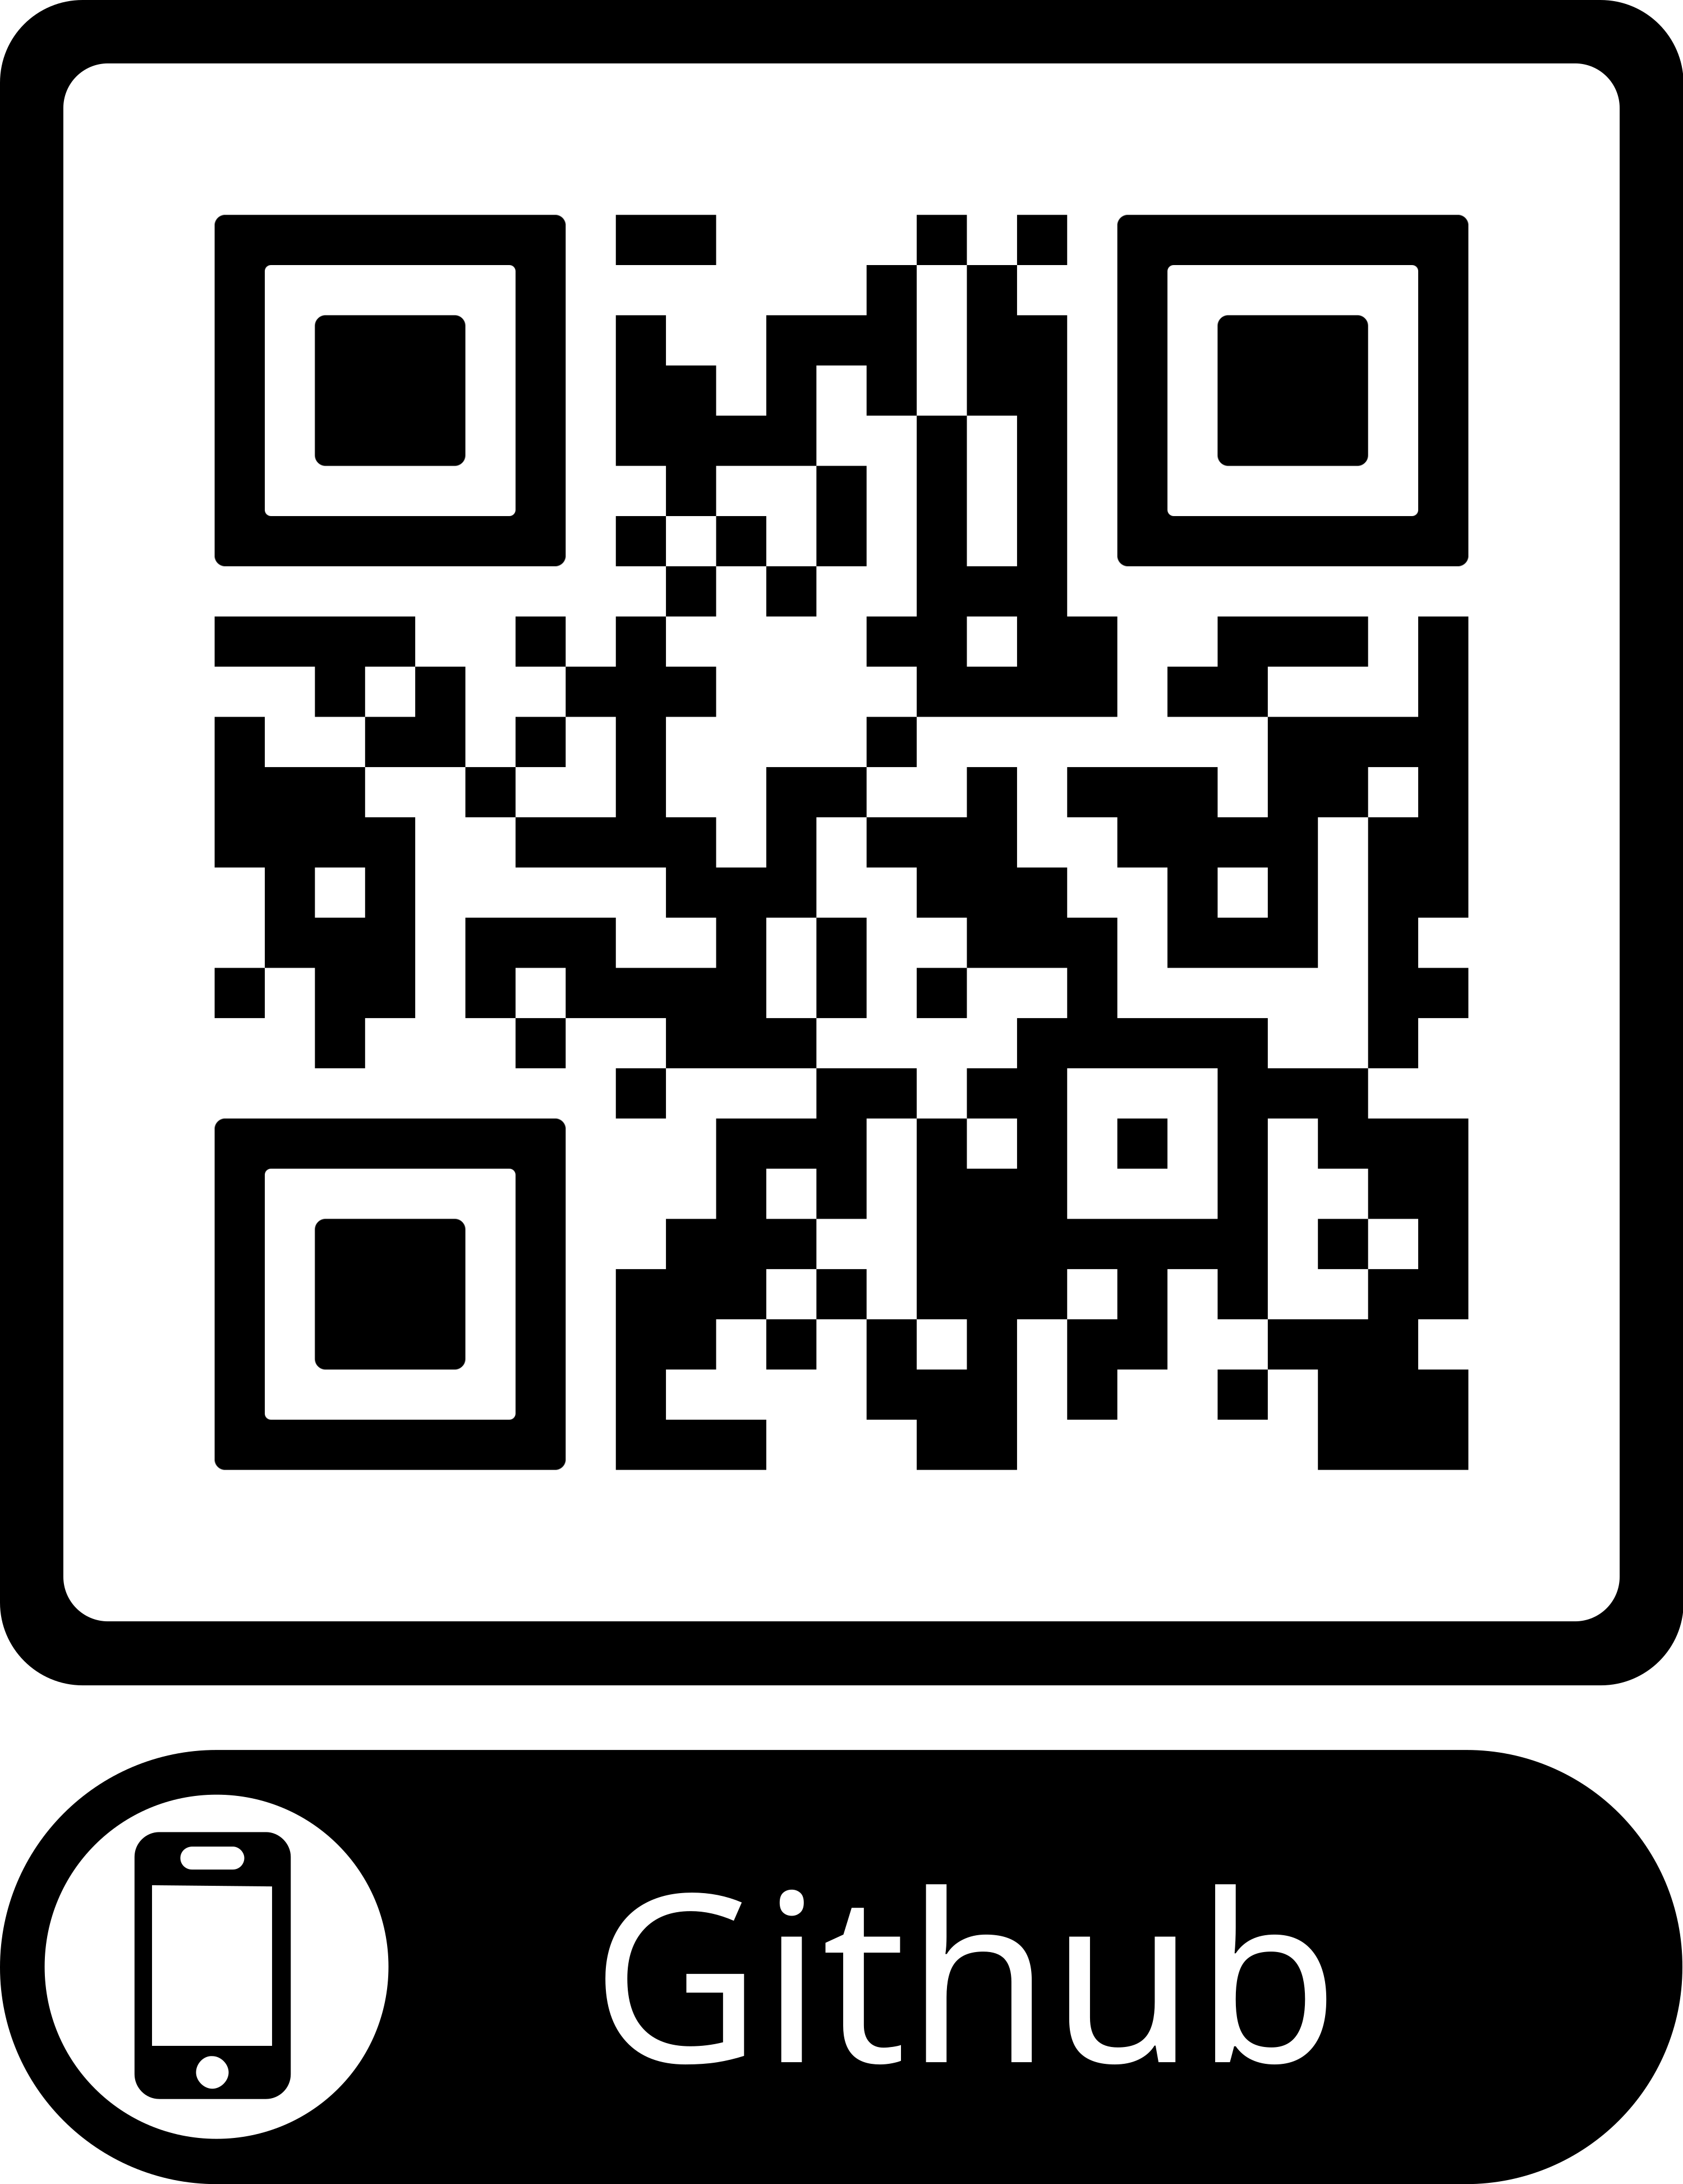
Objectives
Setting up the rubber ducky
Know how to use the web base IDE
Generate payload
Launching the payload

Slide 3
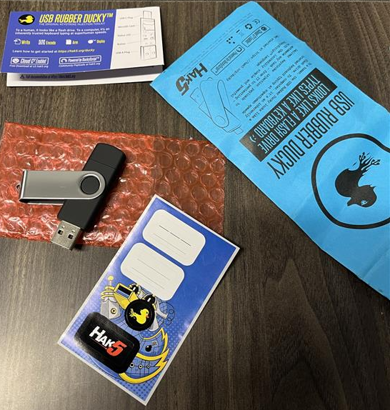
What You Get With Your Ducky
Info Card
USB Rubber Ducky
Sticker card

Slide 4
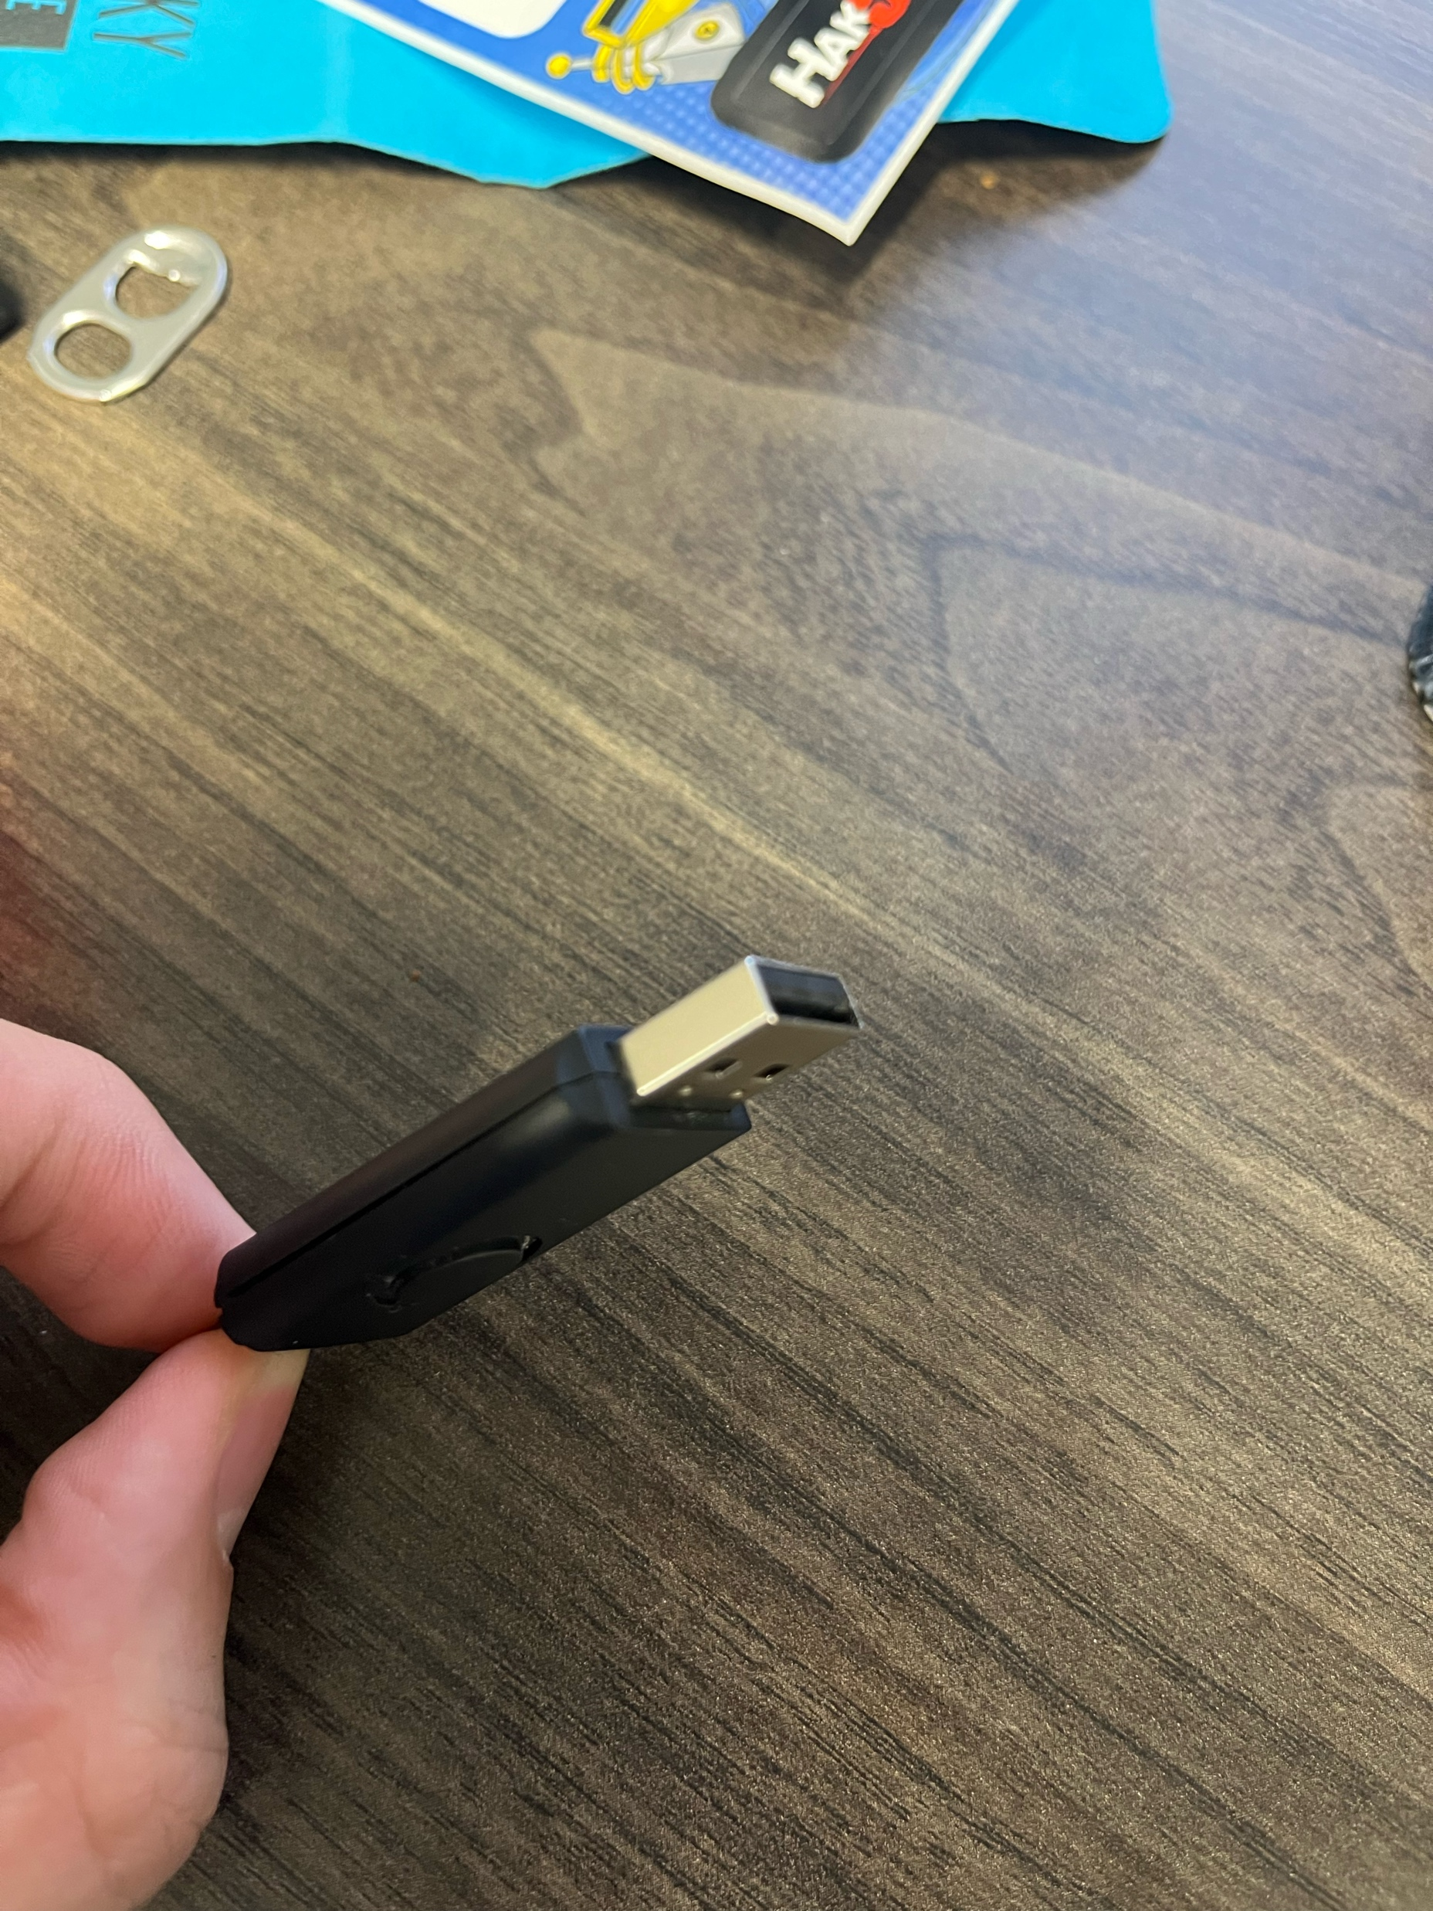
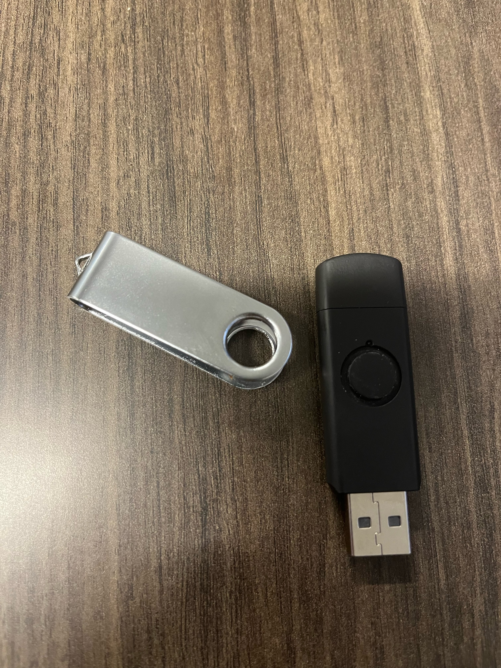
Opening Ducky

Slide 5
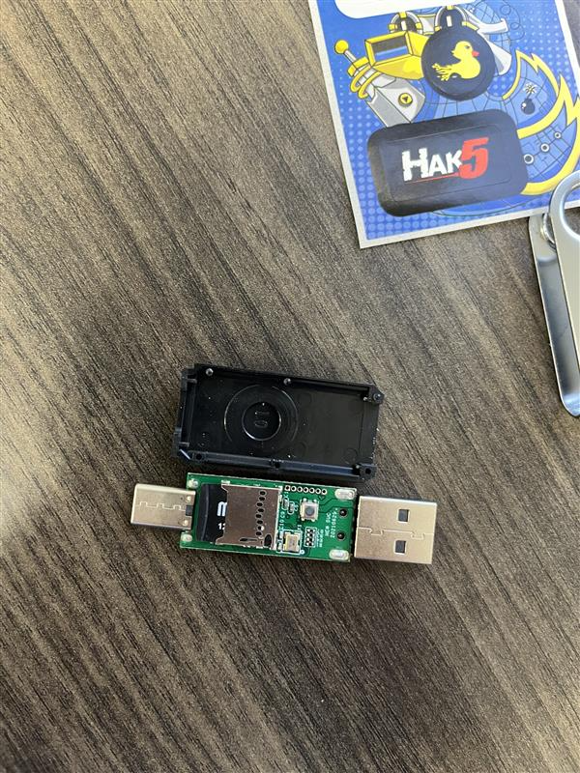
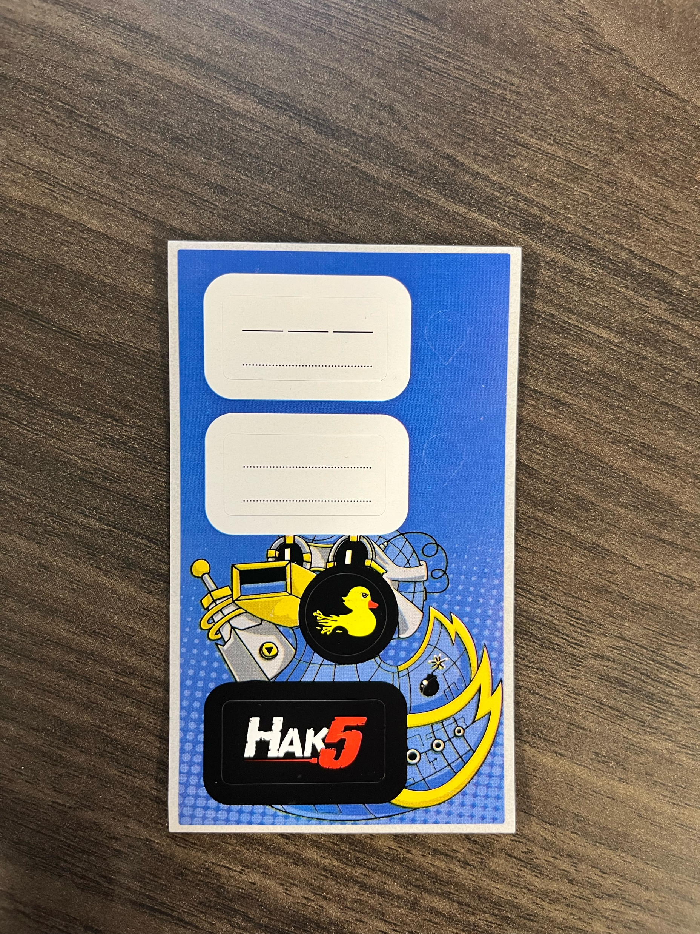
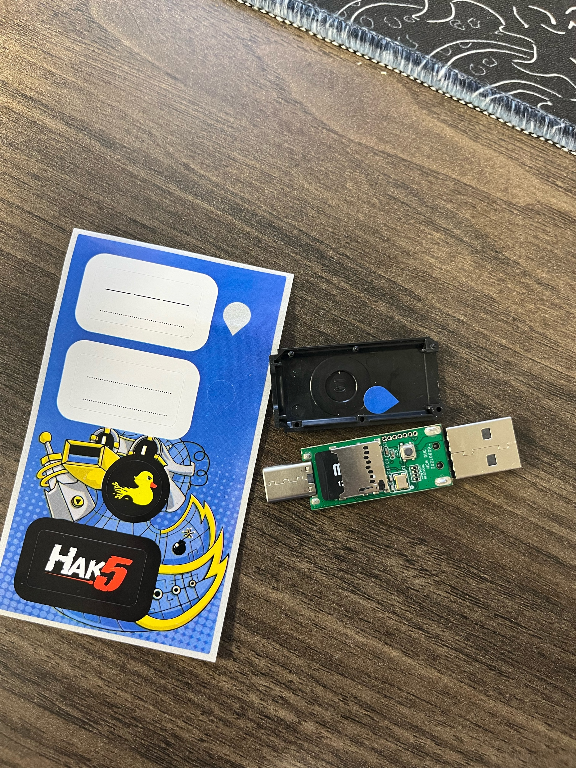
Stickers
USB C SIDE
USB A SIDE
What it should look like after you put the stickers on

Slide 6
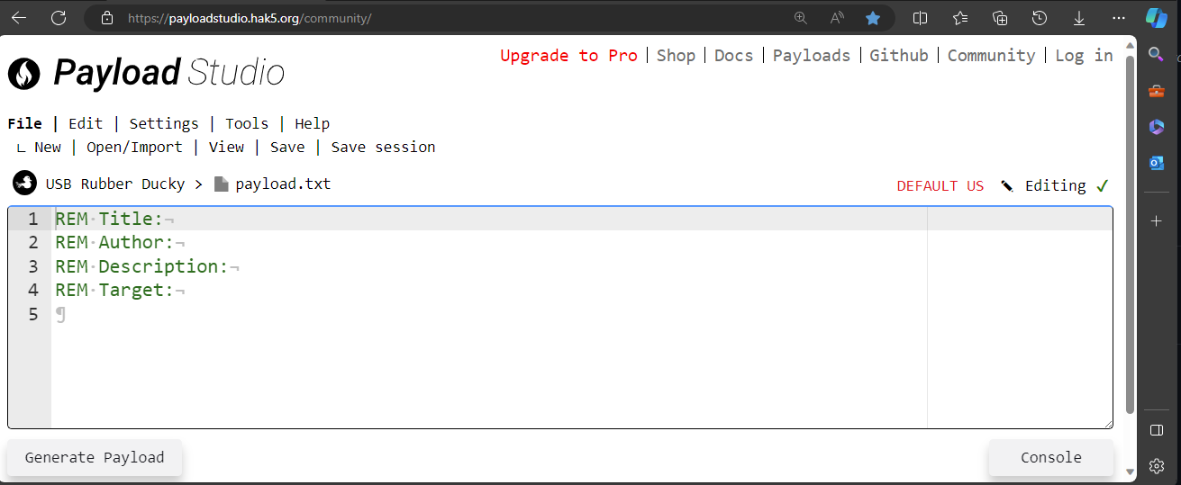
Payload Studio IDE
Notes:
Talk about the IDE and how to use it

Slide 7
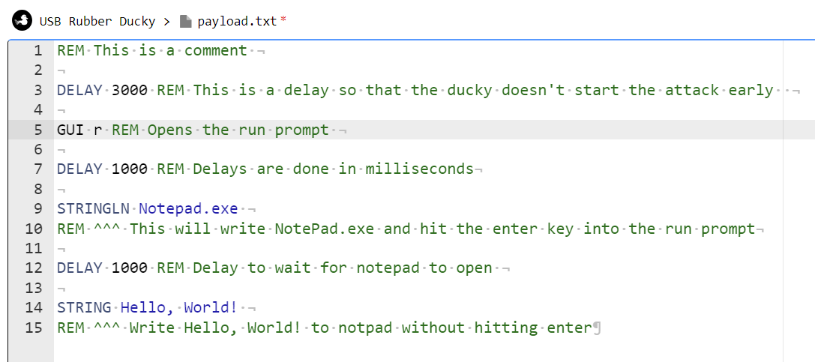
Hello World

Slide 8
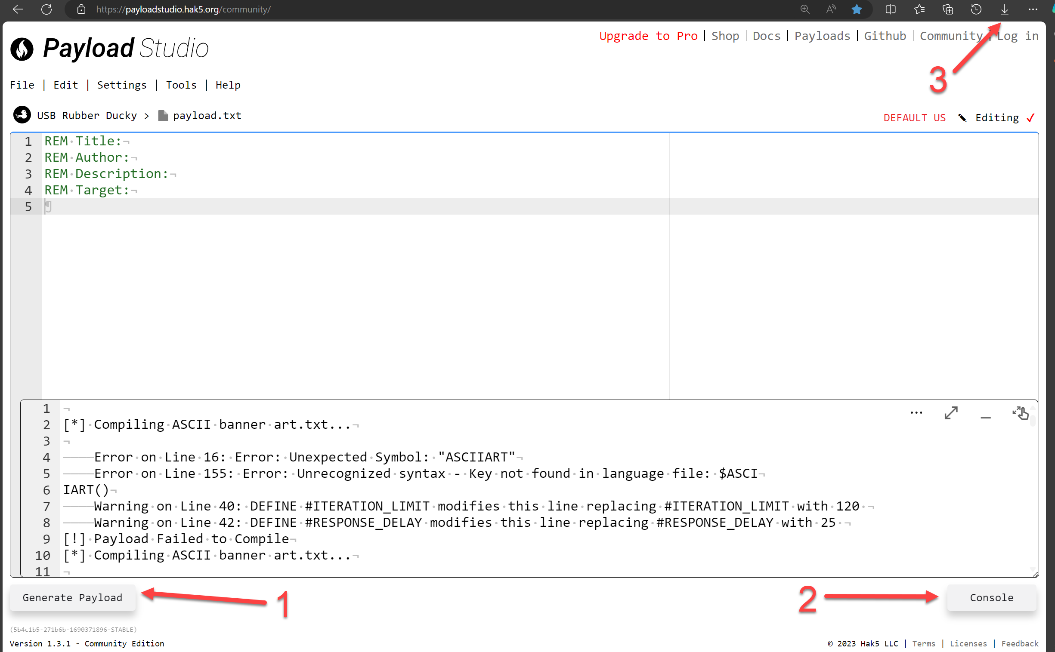
Generate the Payload

Slide 9
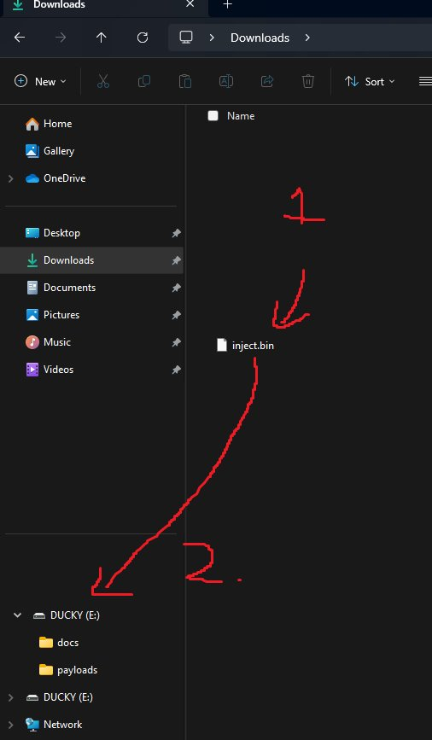
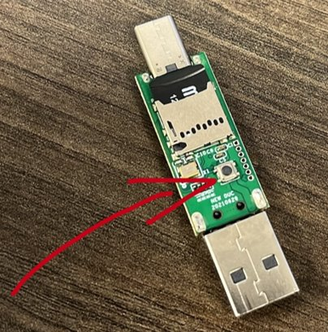
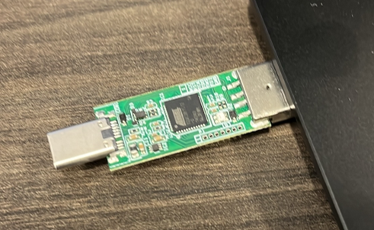
Loading the Payload

Slide 10
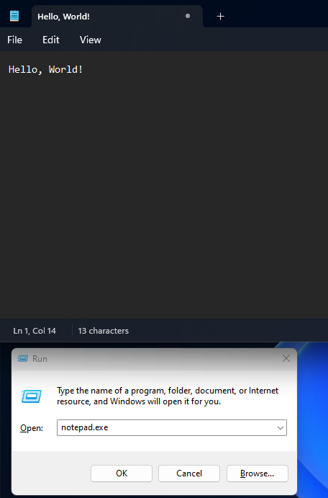
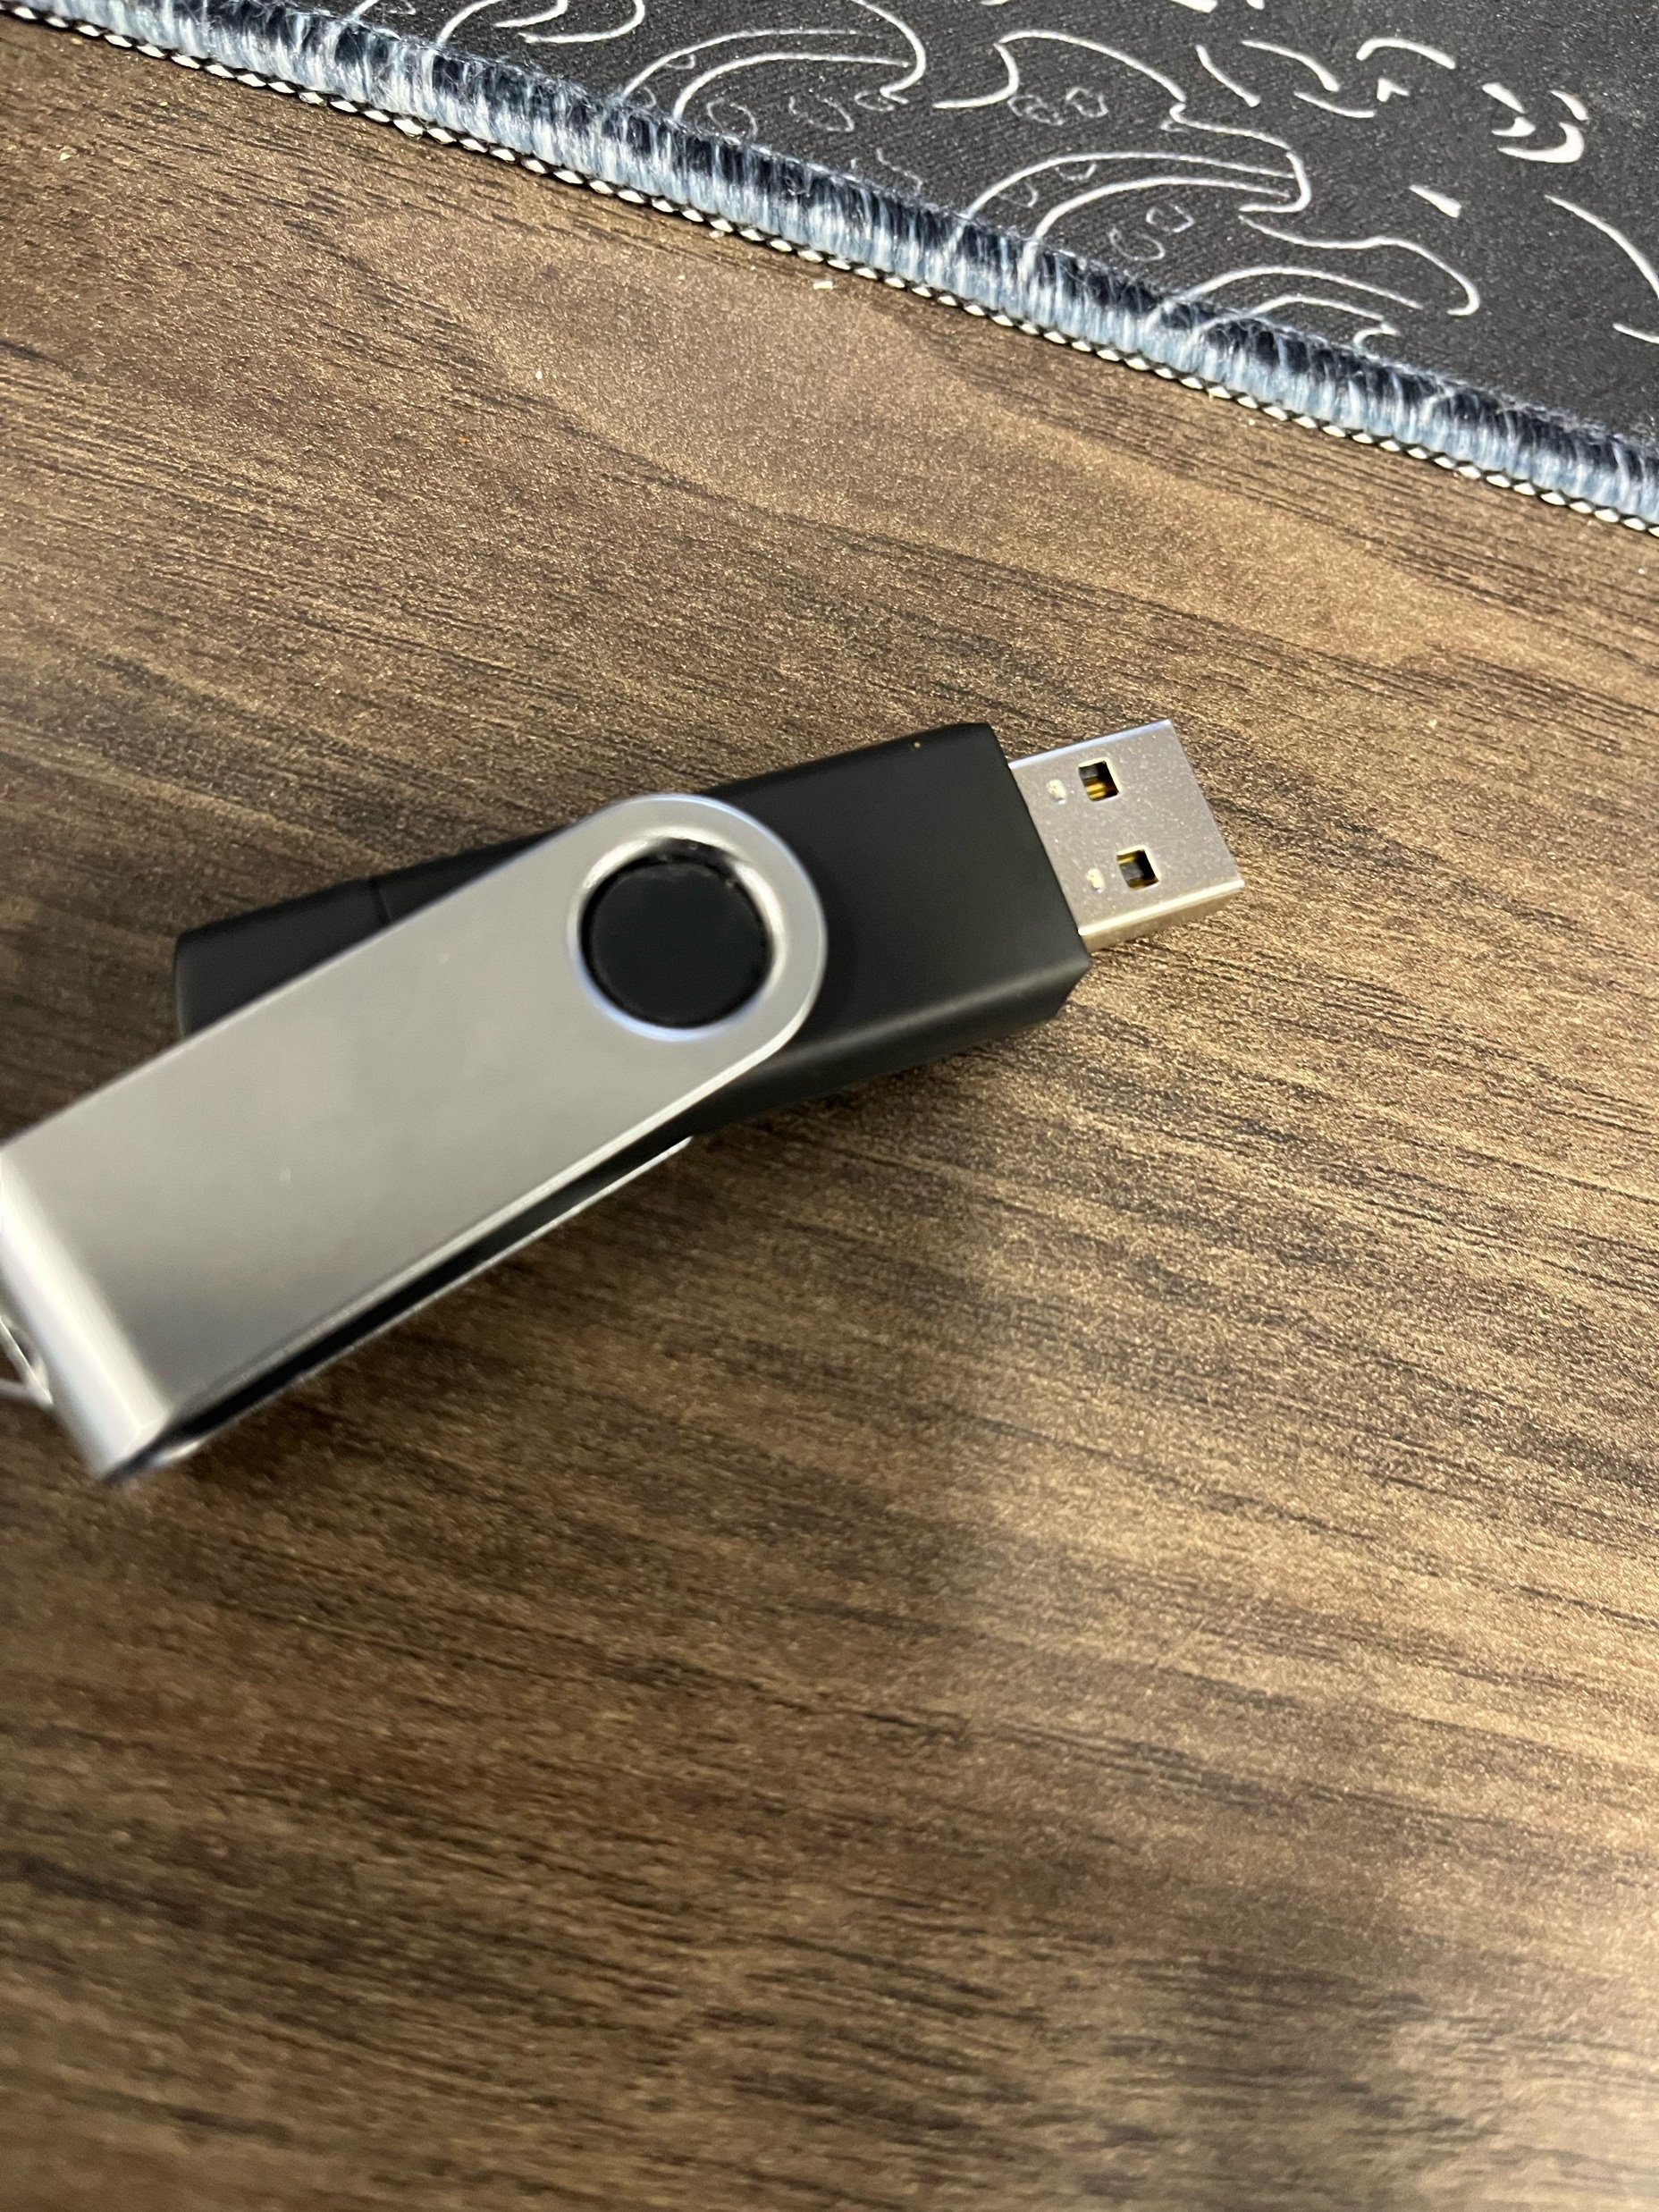
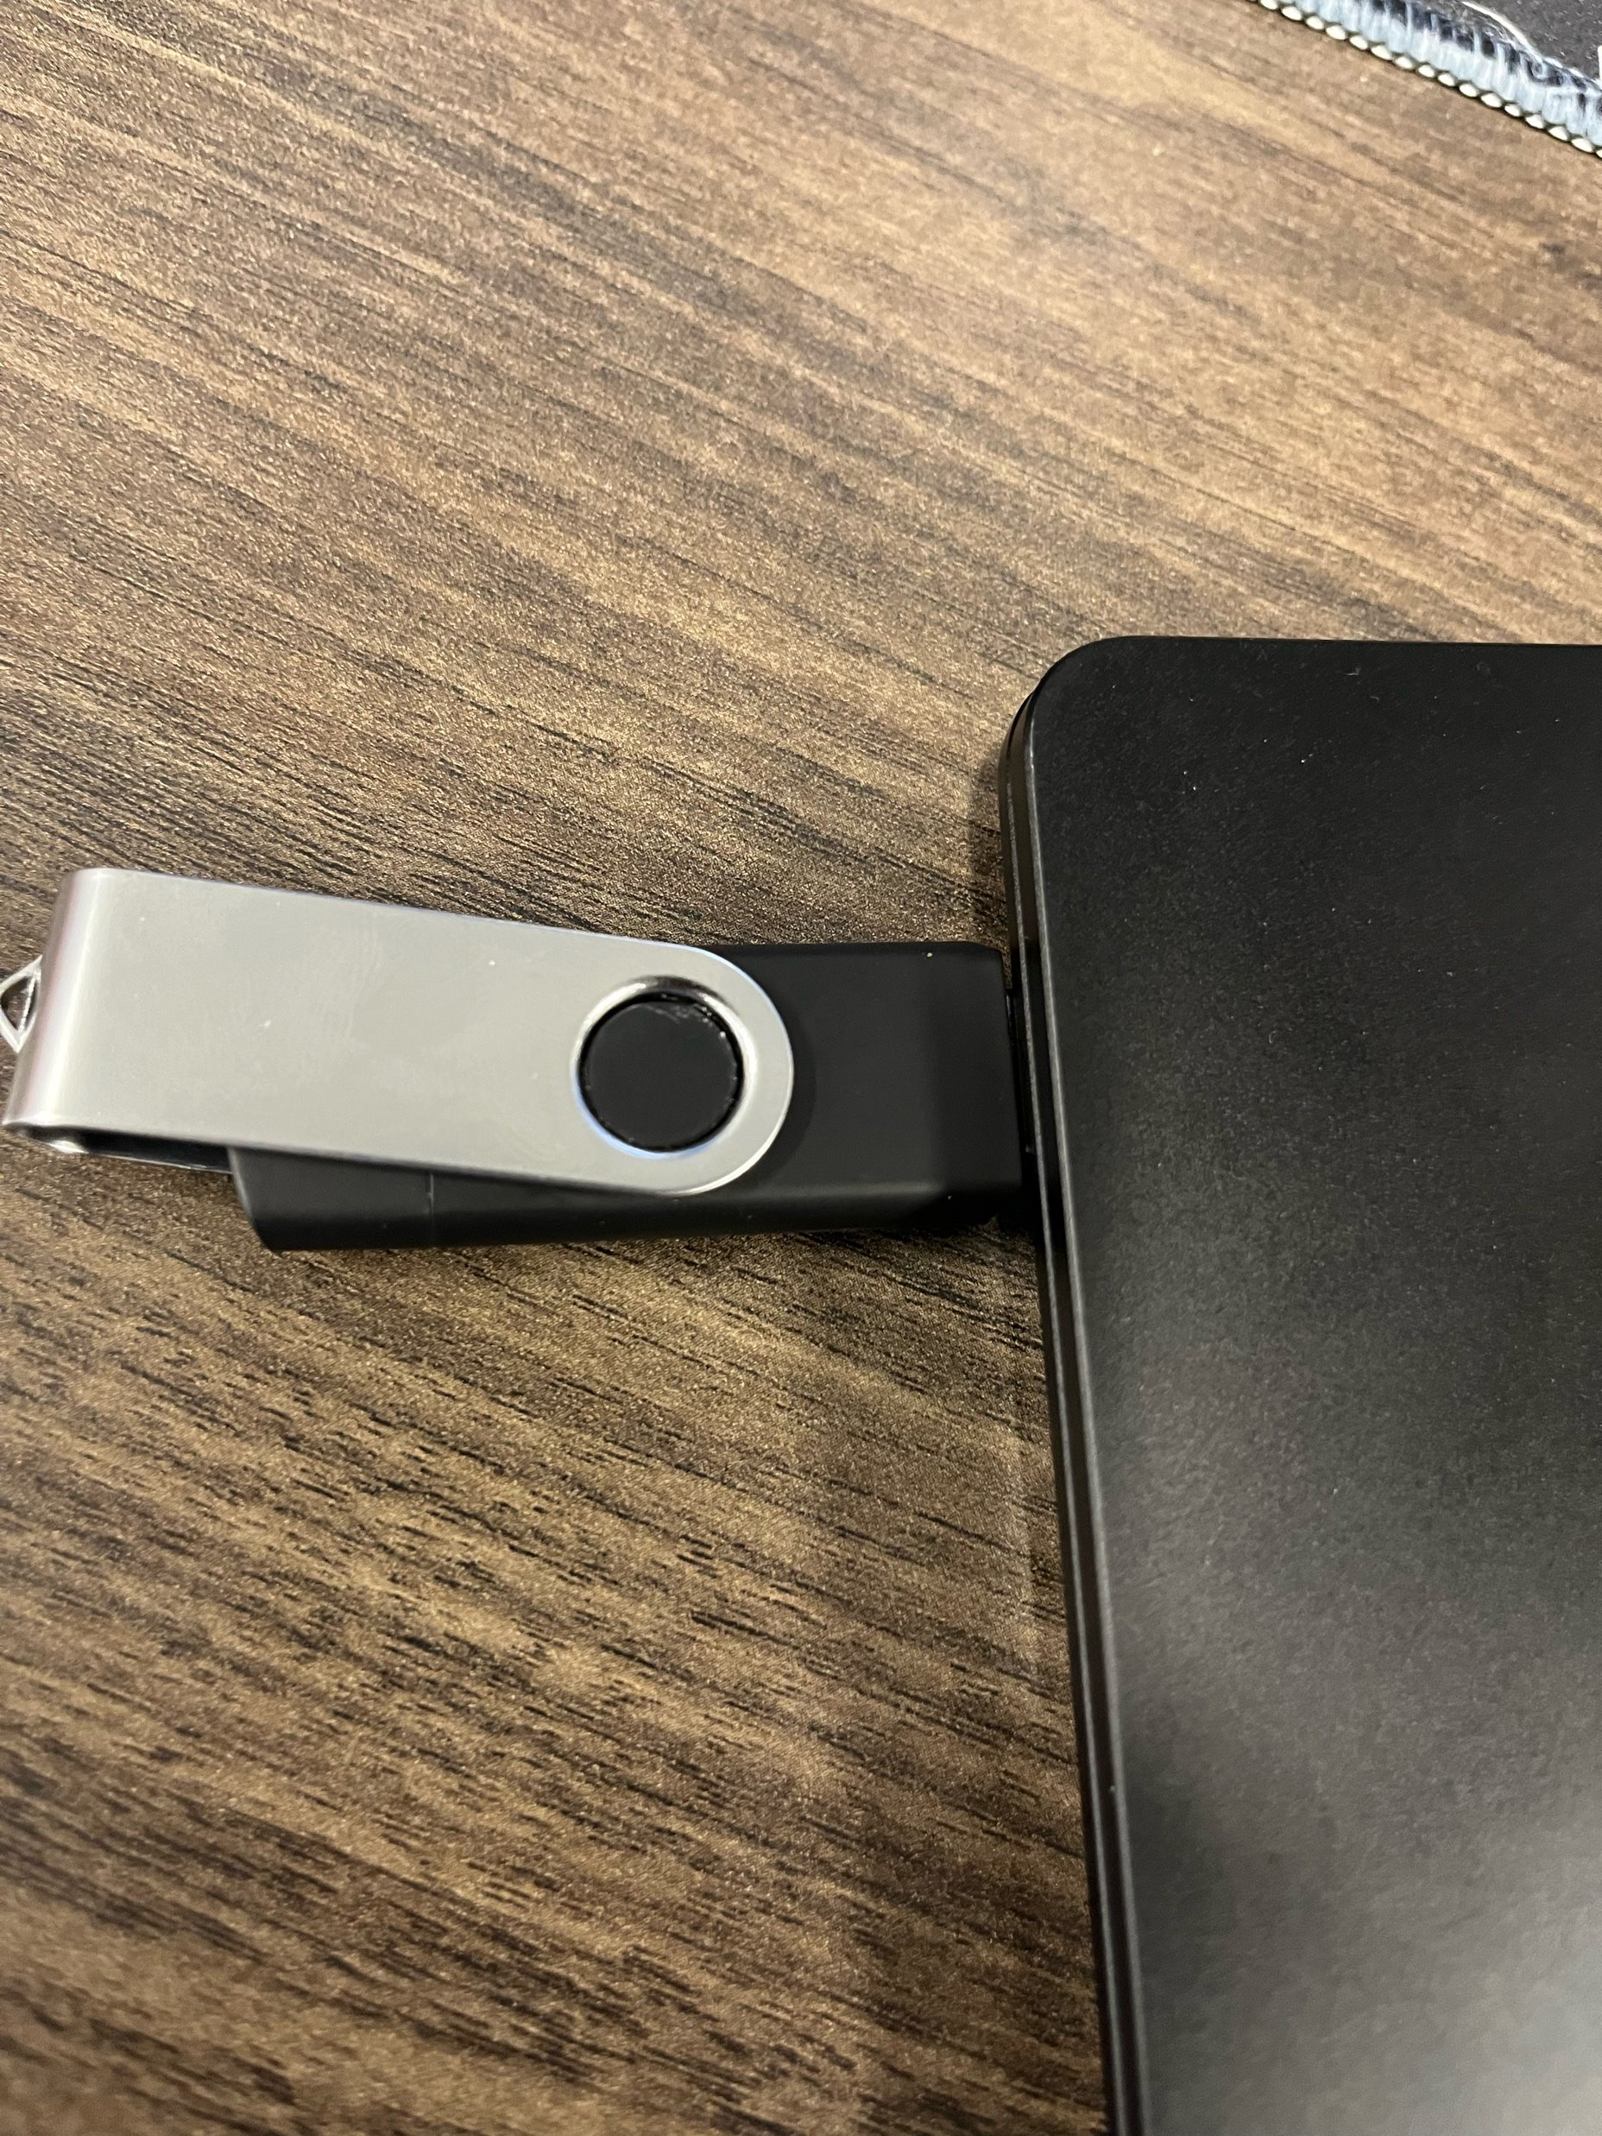
Testing Payload

Slide 11
Your New BFF
Ducky Quick Reference Guild​
https://docs.hak5.org/hak5-usb-rubber-ducky/duckyscript-tm-quick-reference​
Payload Studio​
https://payloadstudio.hak5.org/community/​
Payload Library​
https://github.com/hak5/usbrubberducky-payloads​

Slide 12



